Slide 1


Slide 2


Slide 3
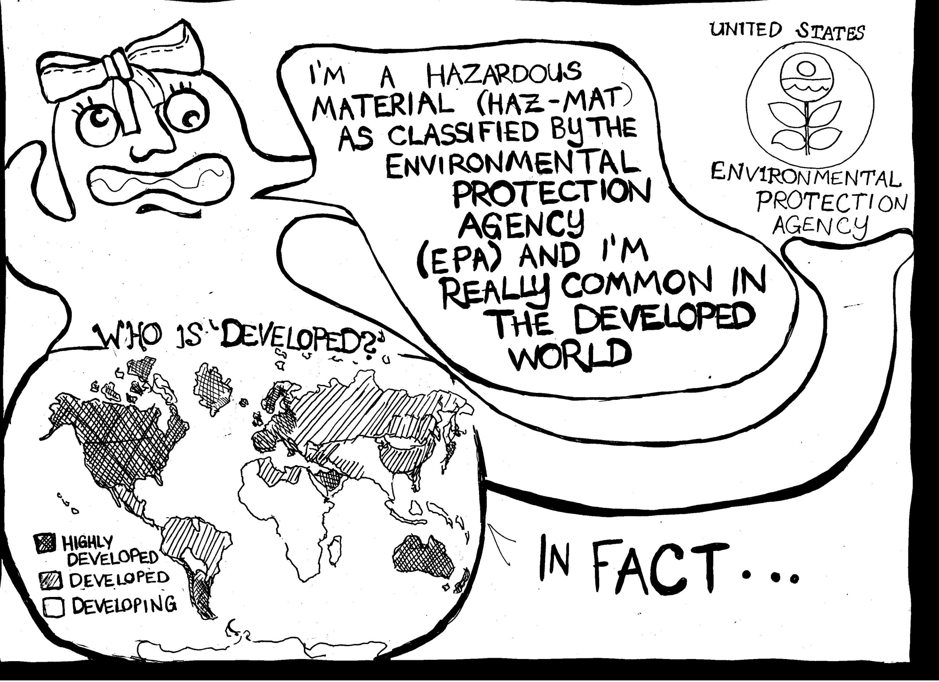

Slide 4


Slide 5
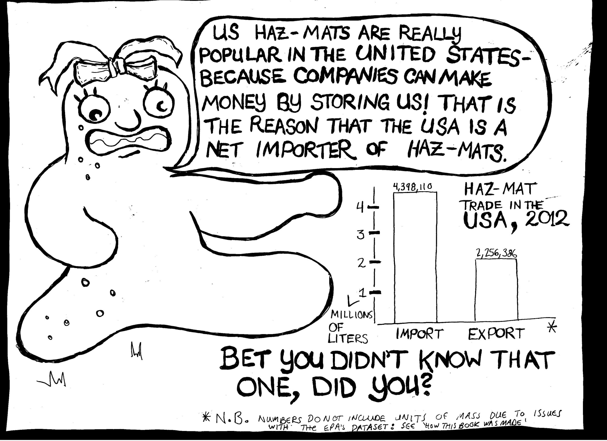

Slide 6


Slide 7


Slide 8
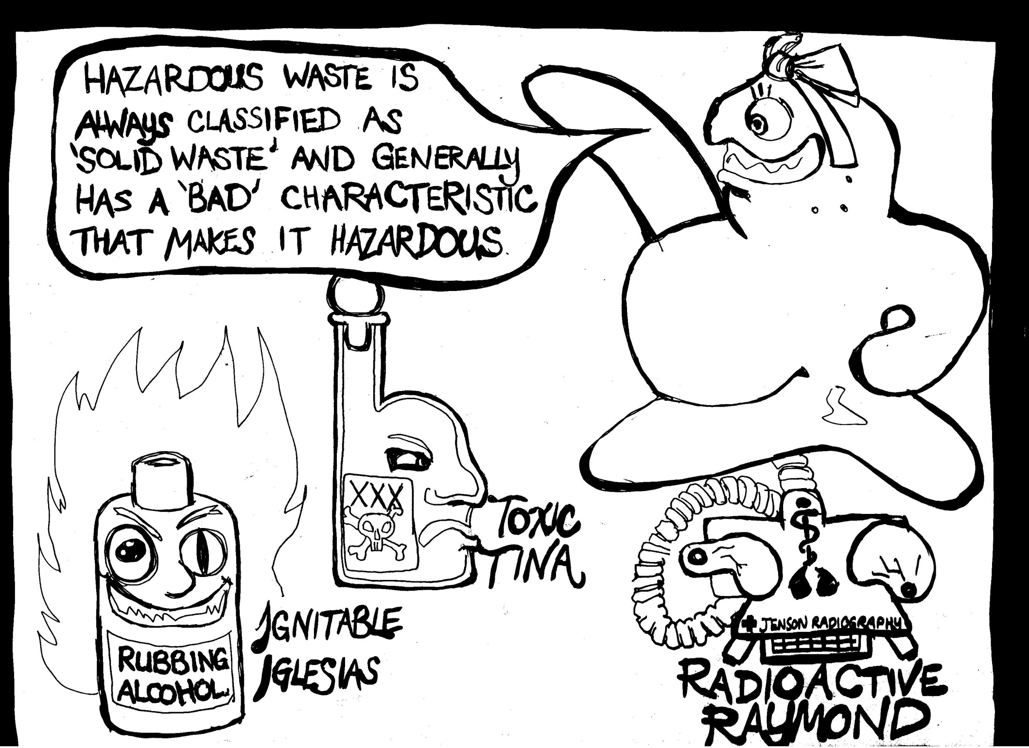

Slide 9
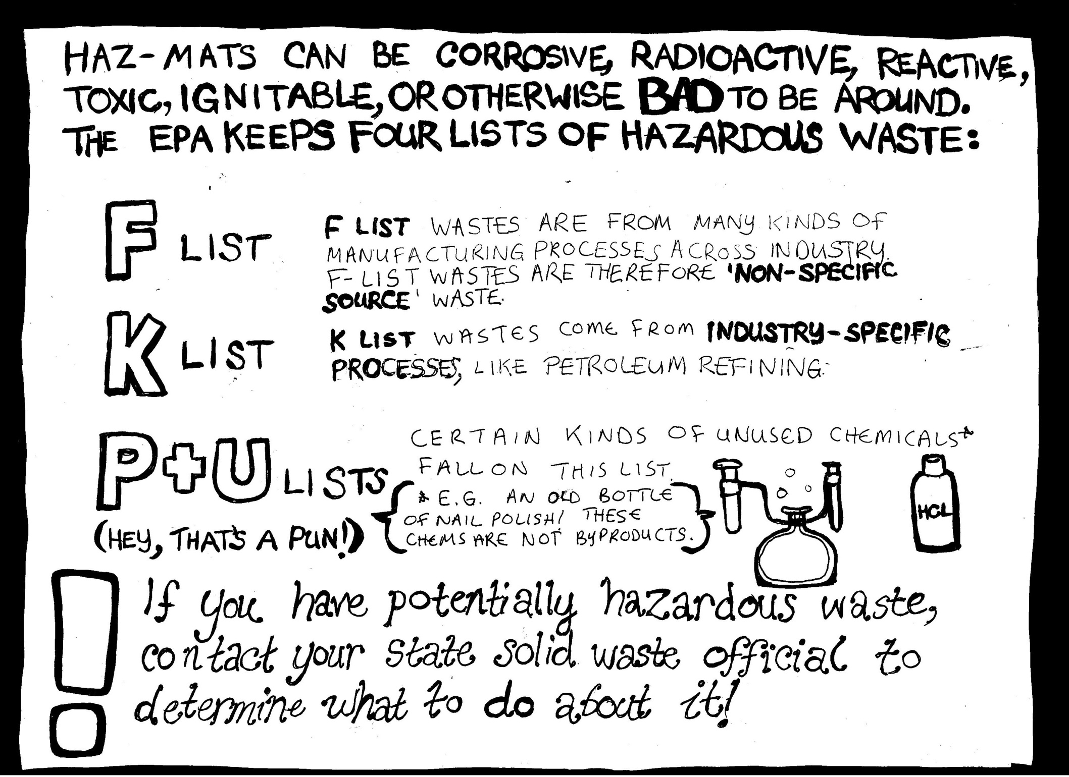

Slide 10


Slide 11


Slide 12


Slide 13


Slide 14


Slide 15
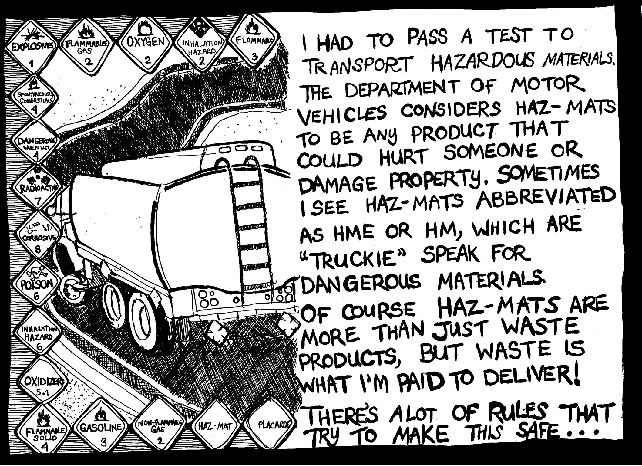

Slide 16
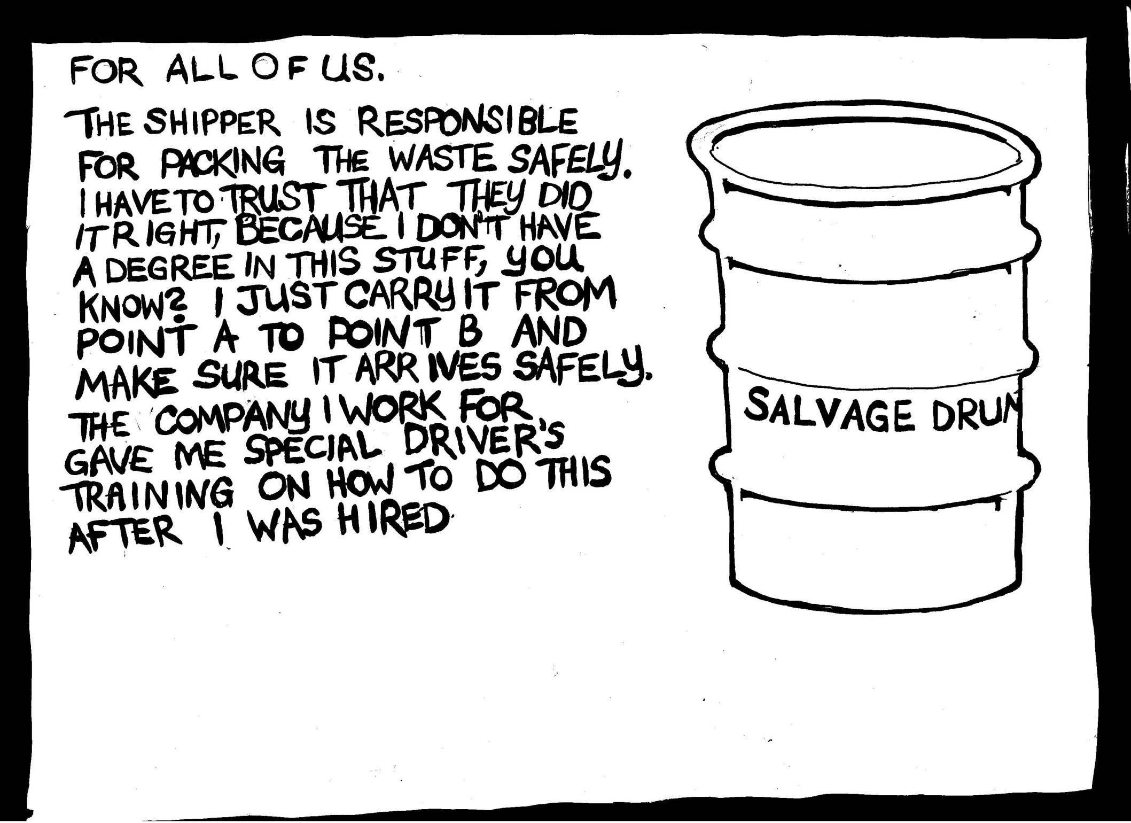

Slide 17
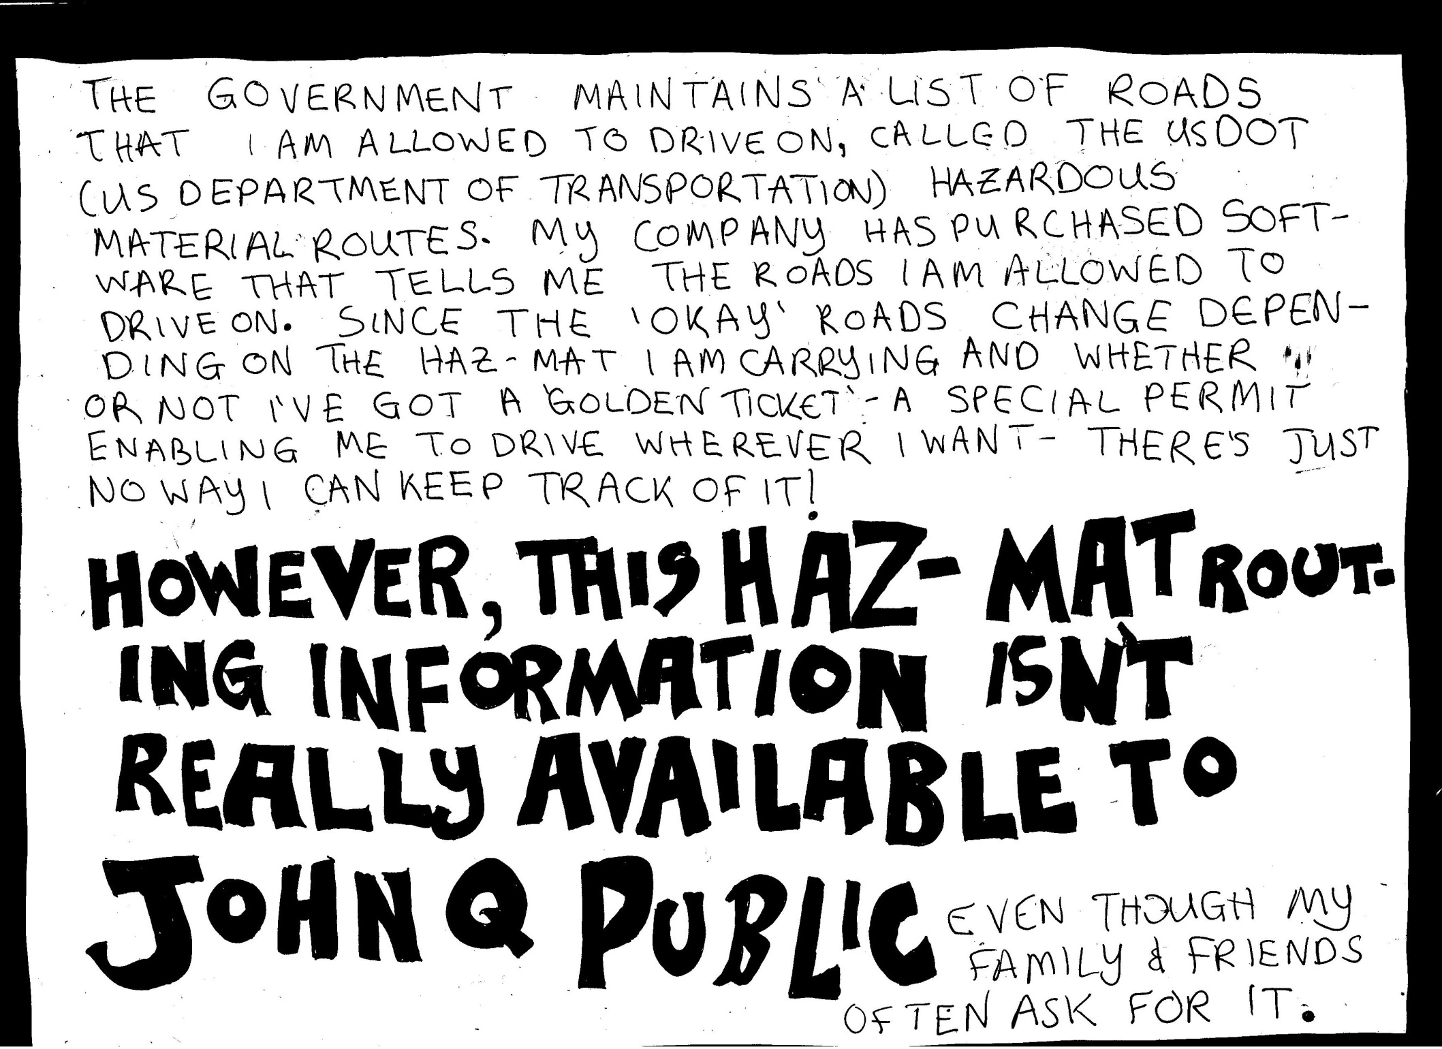

Slide 18
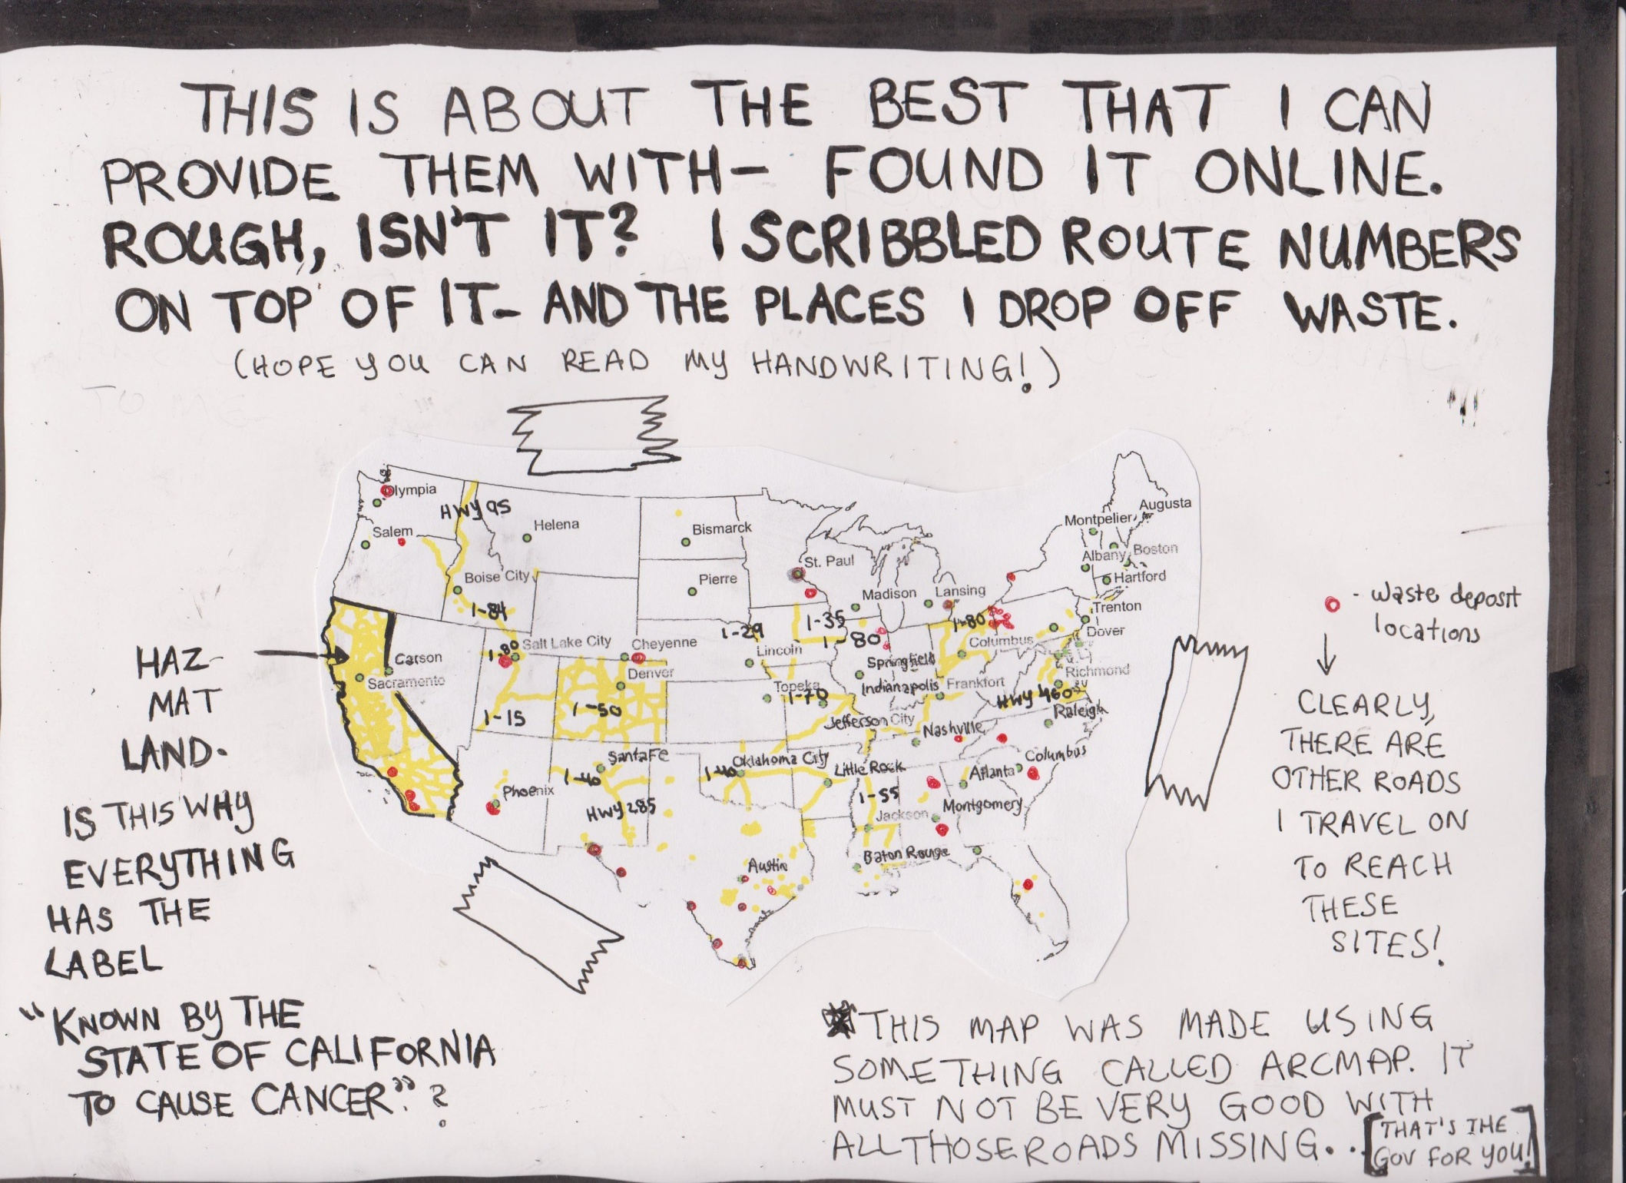

Slide 19


Slide 20


Slide 21


Slide 22


Slide 23
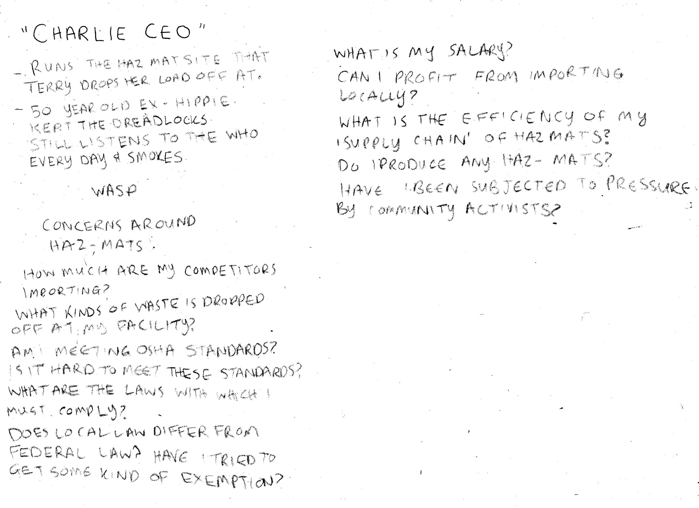

Slide 24
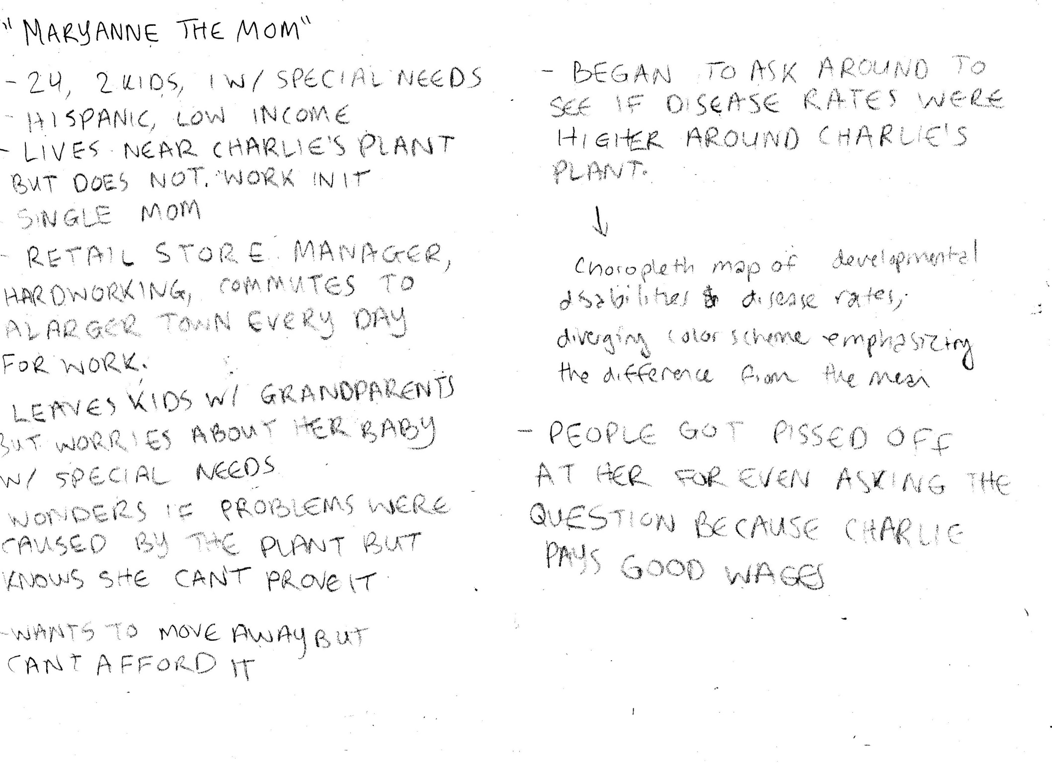

Slide 25
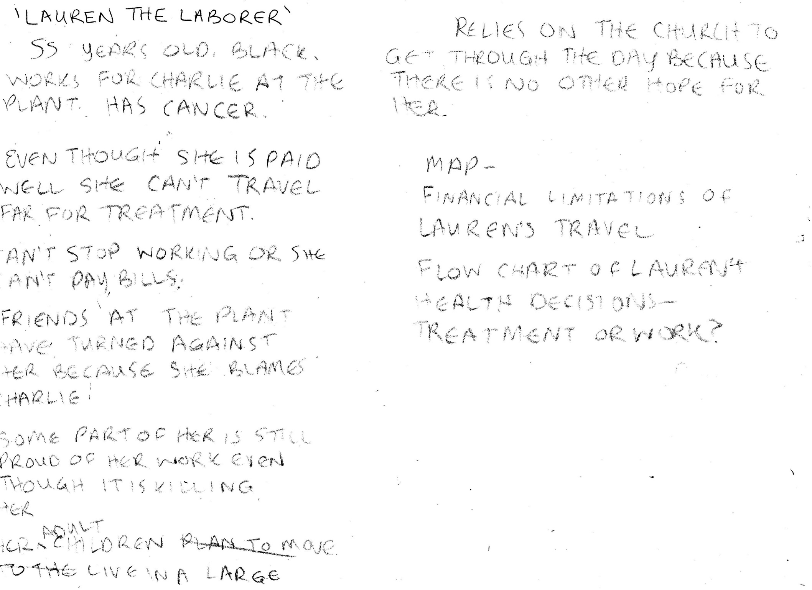

Slide 26
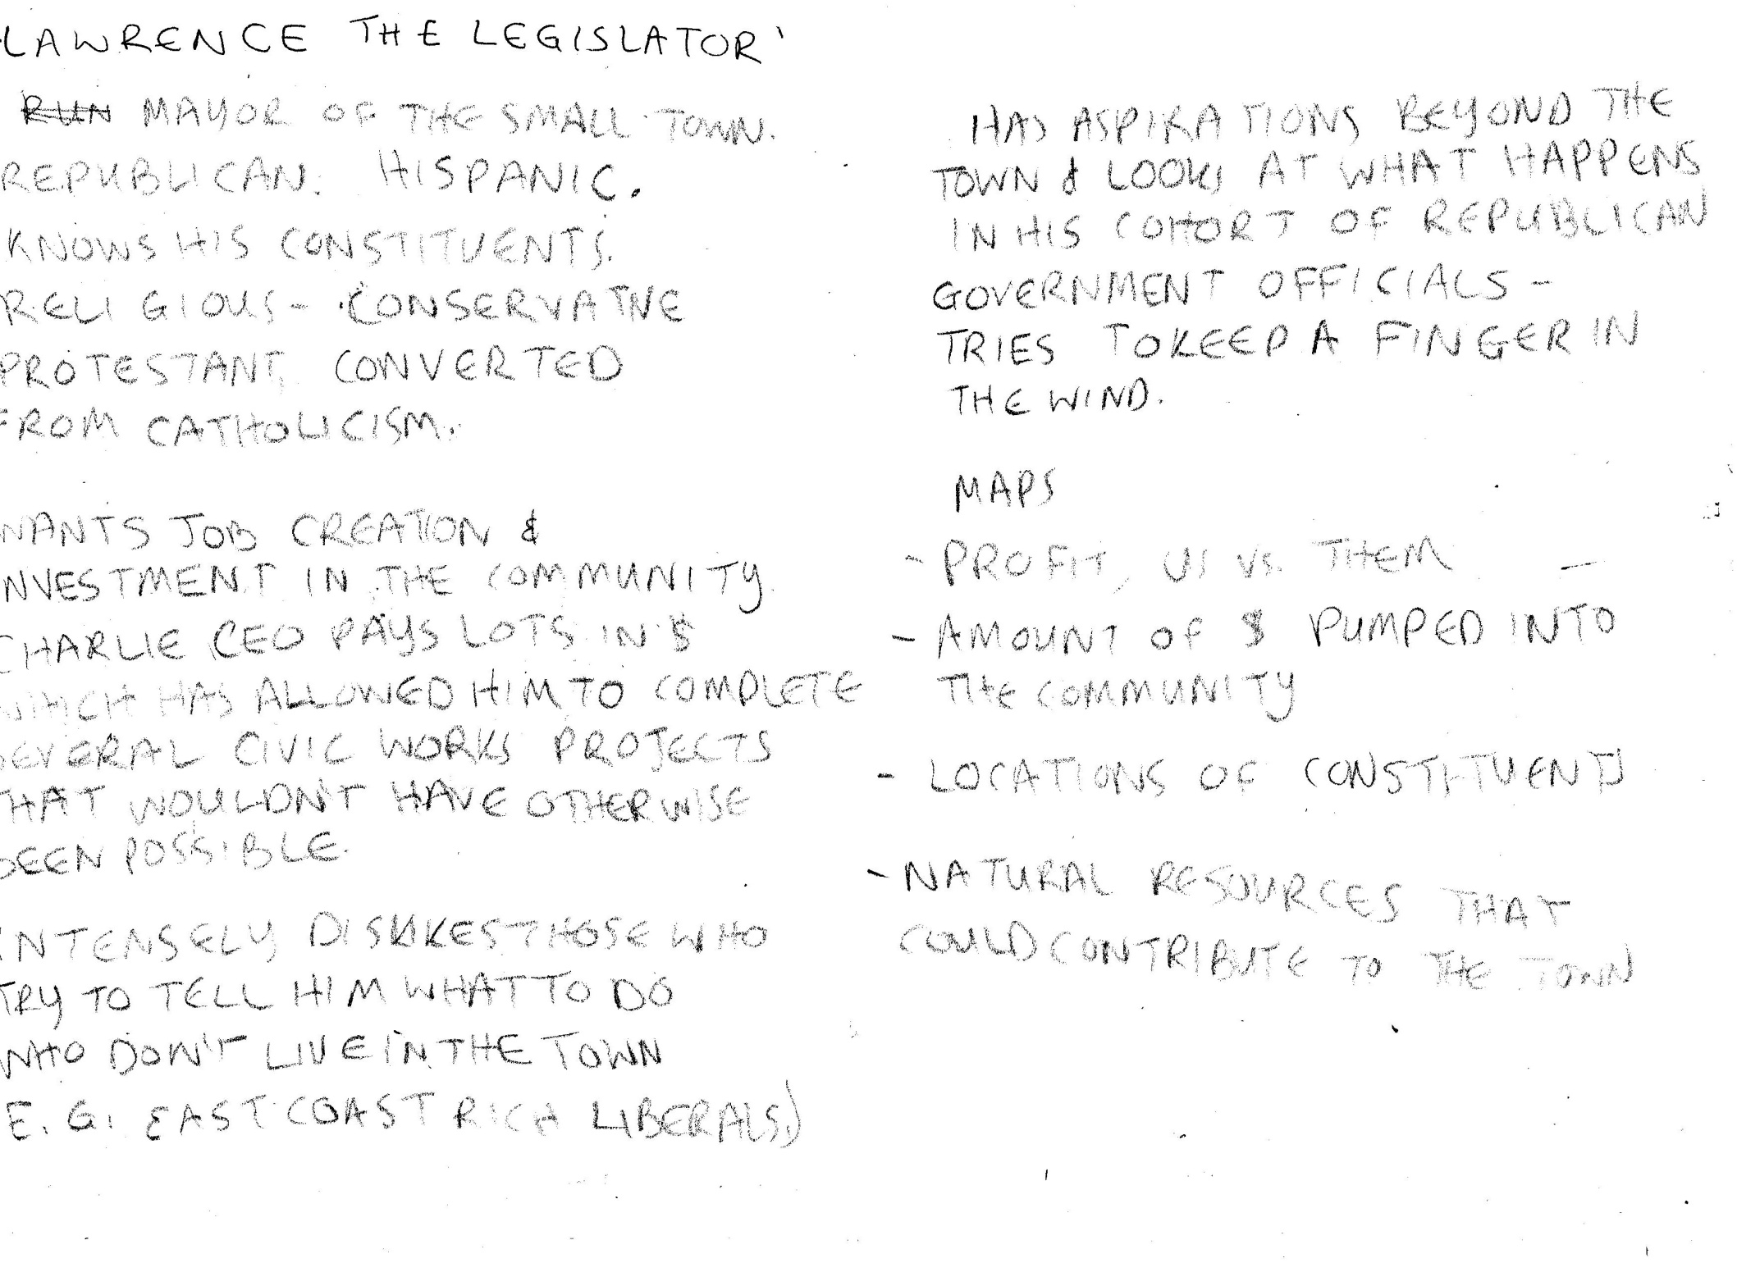

Slide 27


Slide 28


Slide 29


Slide 30


Slide 31


Slide 32


Slide 33


Slide 34


Slide 35
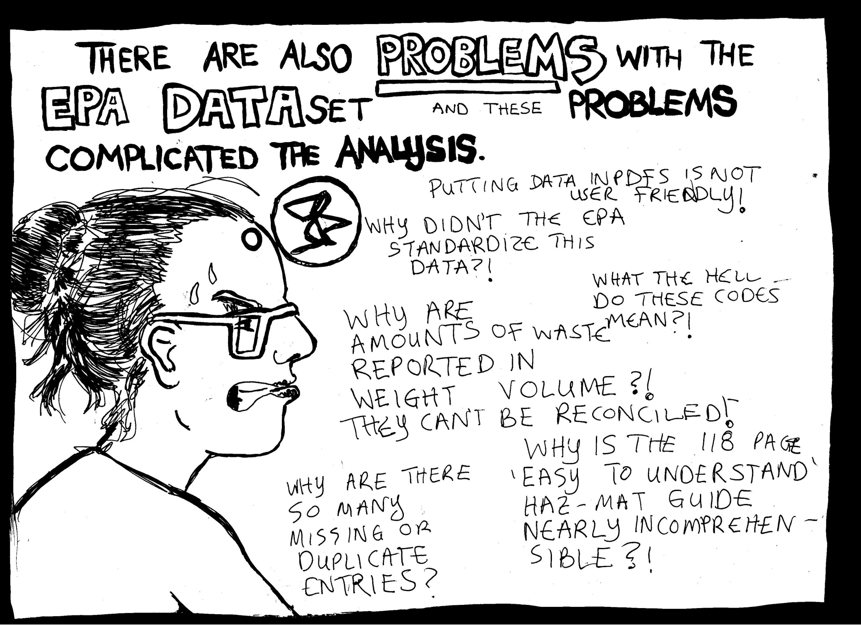

Slide 36
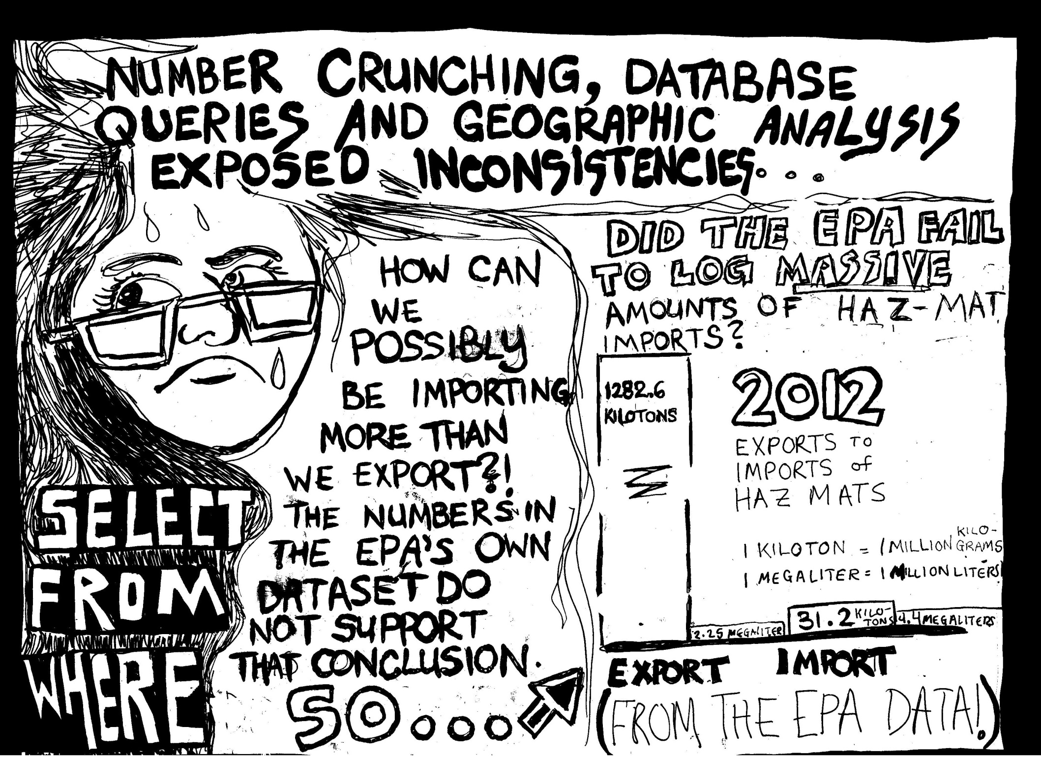

Slide 37
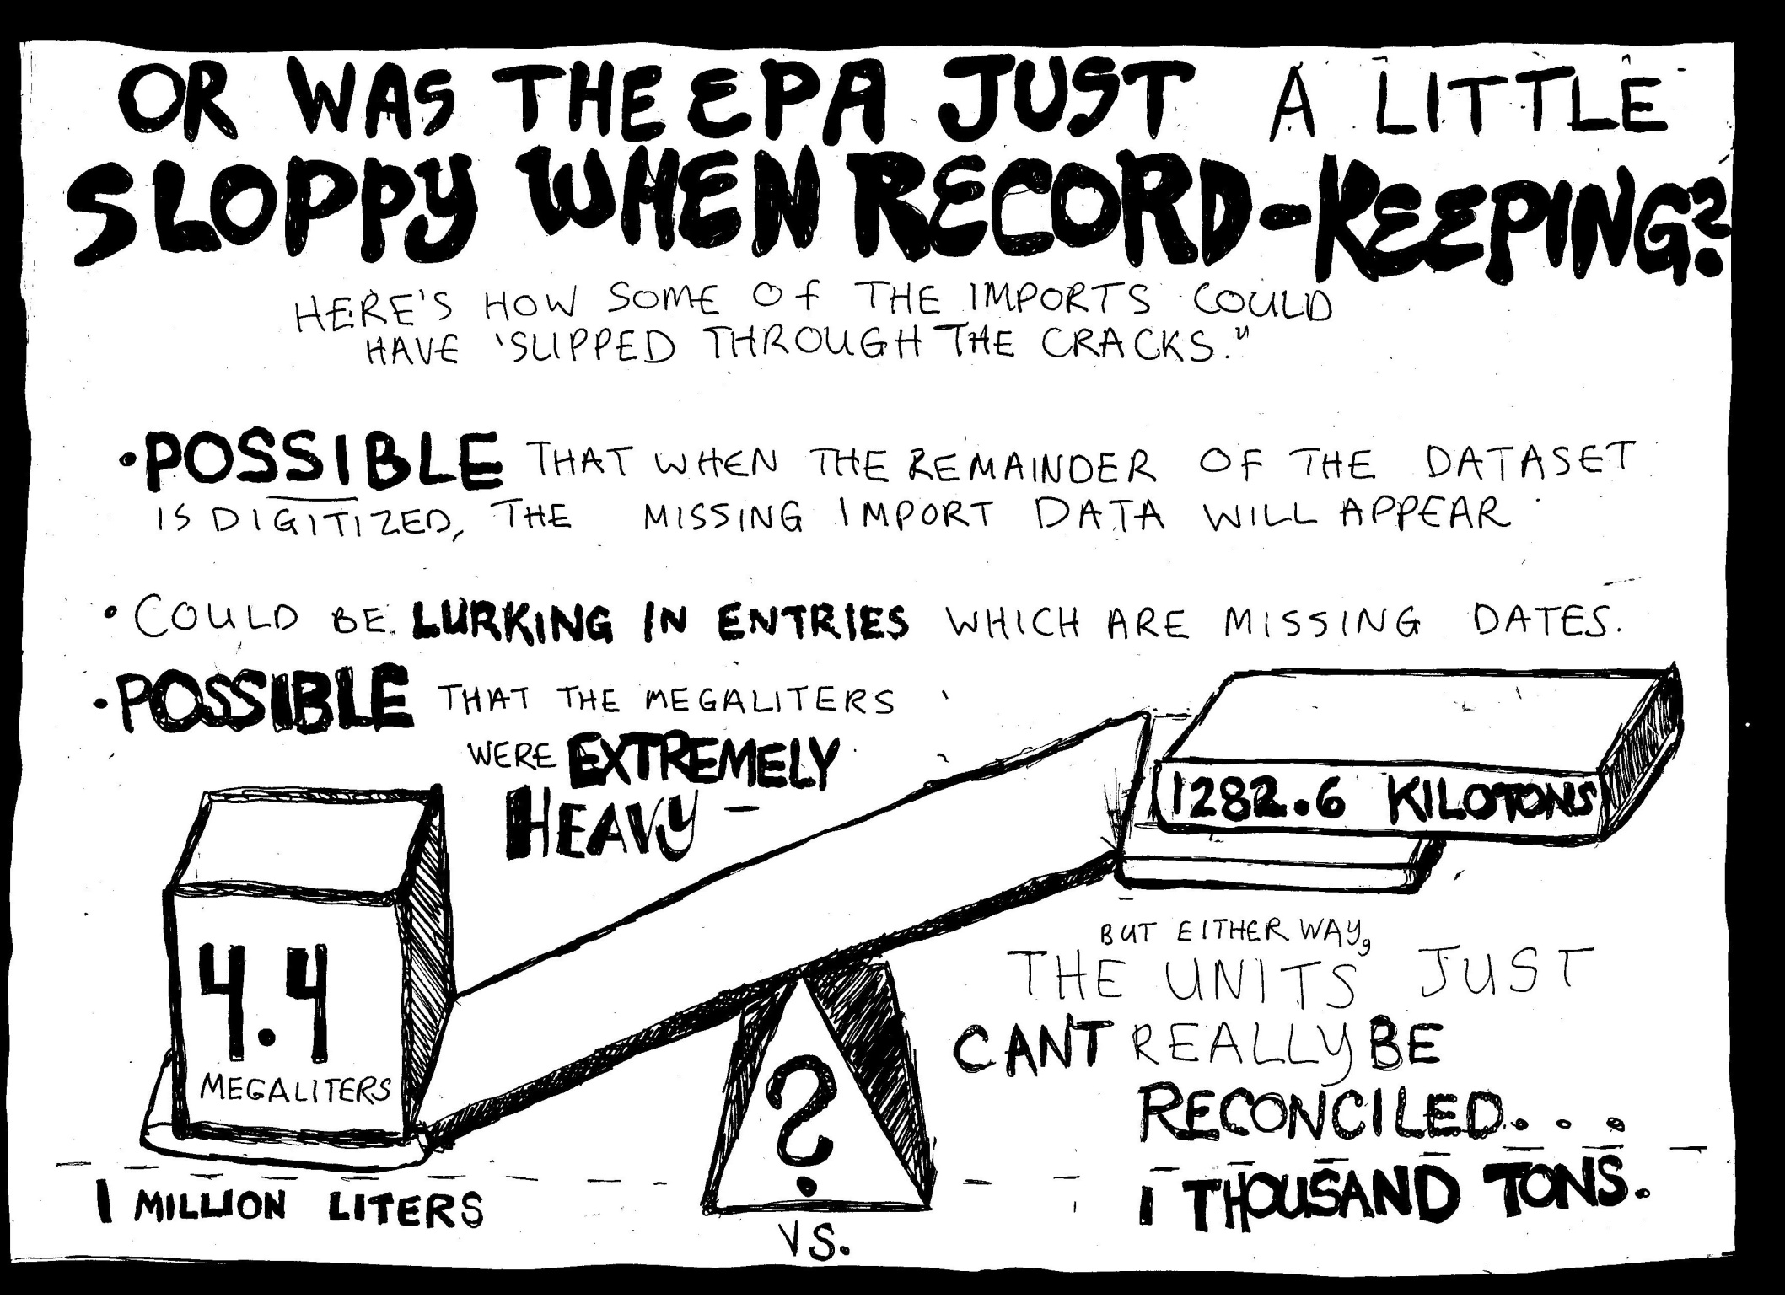

Slide 38
THERE ARE LOTS AND LOTS OF OTHER ANALYSES WITH THIS DATASET THAT I WANT TO DO!
AND I CAN DO, WITH SQL! And a little researching on google…
-Who received the most shipments?
-Who received the most super dangerous shipments?
-What was the most common port of entry into the United States?
-What was the most common haz-mat imported into the United States? Does this haz-mat seem to have some kind of ‘fit’ (is this a really easy haz mat to destroy? is it a really profitable haz-mat to import? etc)
-Which companies are mentioned the most frequently in the data? (and is there anything in the news about these companies and their relationship to the environment / EPA?)
-Who is the biggest domestic importer? Who is the biggest exporter?
-Why was documentation so poor in the years prior to 2012?
I WOULD LIKE TO RELATE THE ANSWERS TO THESE QUESTIONS TO MY FOUR SCENARIOS, WHICH I HOPETO CENTER AROUND A PARTICULAR LOCATION – PERHAPS THE FACILITY IN DETROIT! And there will be, of course, many other questions which will come up as I continue to work on this dataset! ☺

Slide 39


Slide 40
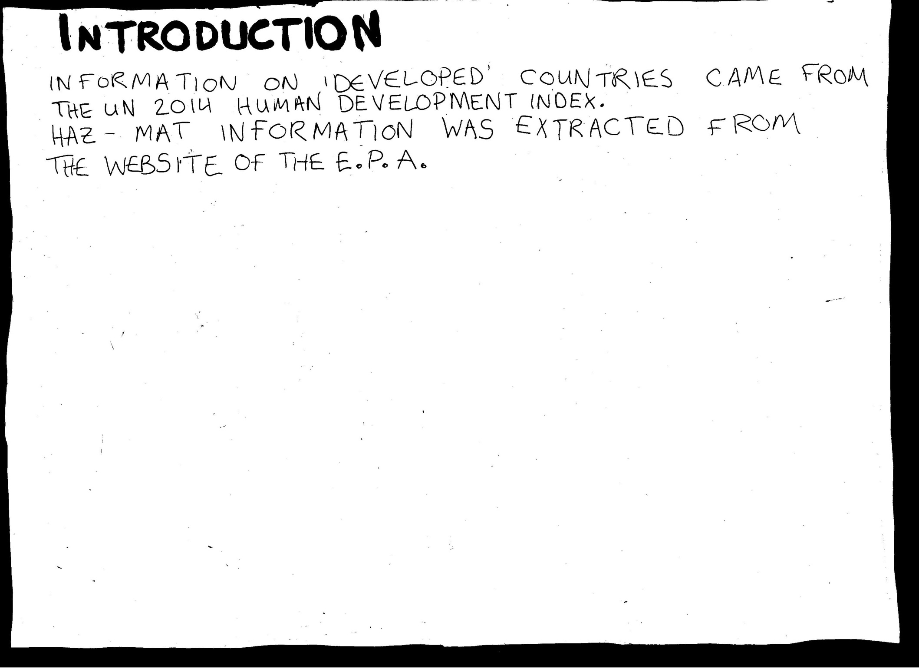

Slide 41
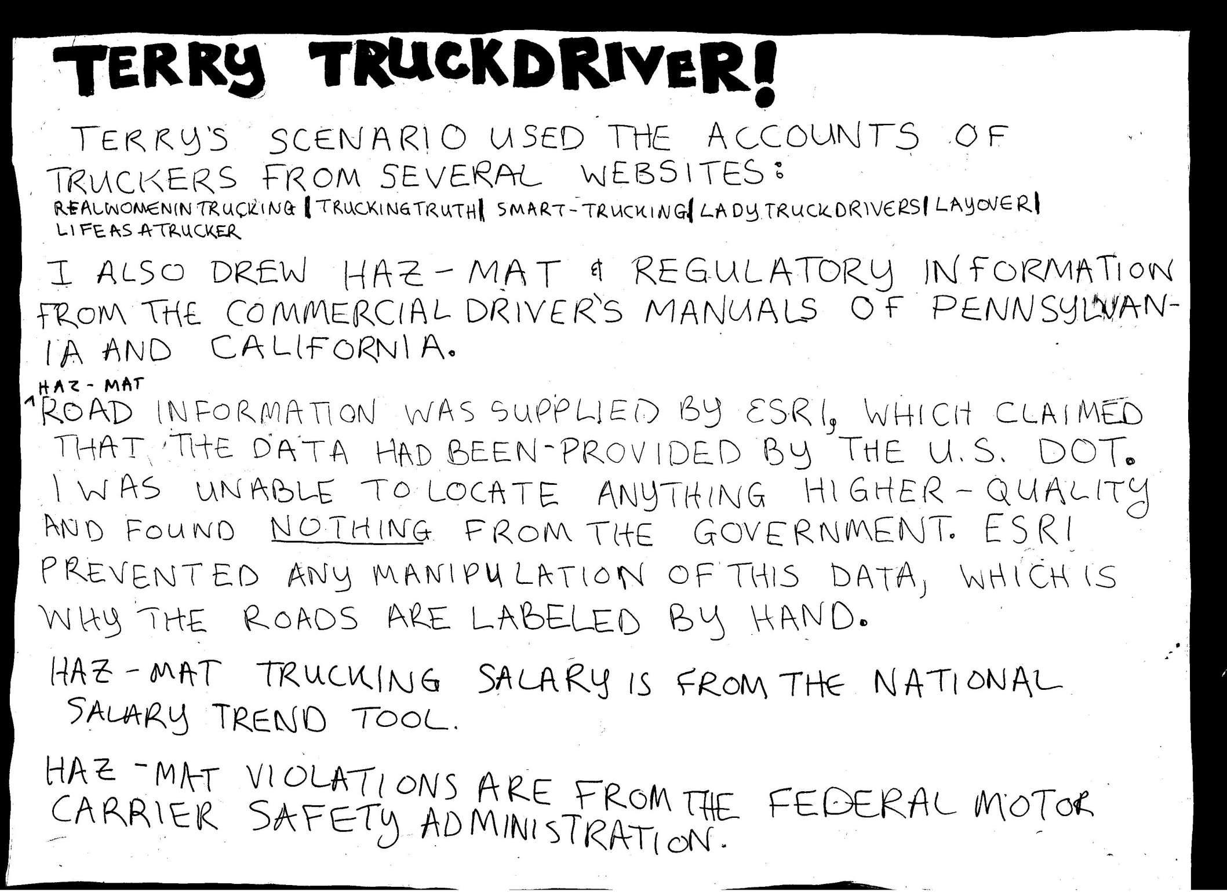

Slide 42


